Slide 1
Guess the number
Team12
Jungin Chang
Paige Hartley
Alex Hureaux-Perron
Minseok Sakong

Slide 2
Goal / Motivation
A simple game sounded fun!
We’ll get to utilize a timer, keyboard input, and VGA output.
The goal is to create a 2 player game that can be played from the keyboard, with text output to the VGA.

Slide 3
Short Functionality
Game Start
Announces the start of BINGO game in VGA
Displays remaining timer in 7 segment display
Assign each player 3 lives(# of tries for each round)
2. Round1(Assuming player 2 guessed a number, which is not the BINGO number)
Random BINGO number is generated internally
Timer counts from 10 to 0 for player 1
Player 1 guesses the number with keyboard inputs
VGA tells players, which the guessed number is below/above the BINGO number
Player 1’s one life gets taken away
Player 1 timer gets reseted to 10
3. Round 1 (Assuming player 2 guessed the BINGO number)
Vga displays the winning player and speaker outputs congratulation beeps
Rounds go on

Slide 4
Short Specification
7 Segment Display [Timer for each player]
- Counts down from 10 to 0
VGA [Display of the game information]
- Displays round number, each player’s remaining lives, and result of each round
Keyboard module [Controls inputs]
- Gets guessed number inputs from each player
LFSR module [Generate random numbers]
- Generates BINGO number for each round

Slide 5
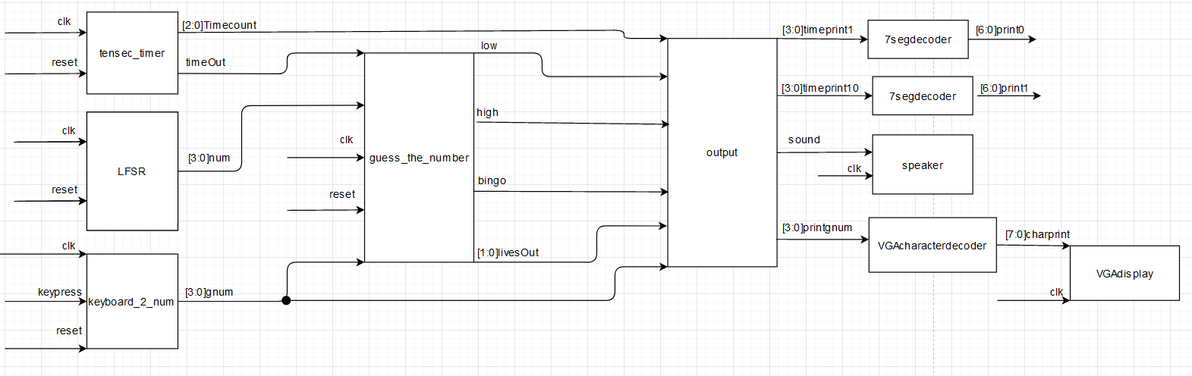
Detailed Block Diagram https://drive.google.com/file/d/1Tpcd9qbDrSzvFJAv5q5VAzxwBxLCSJK_/view?usp=sharing

Slide 6
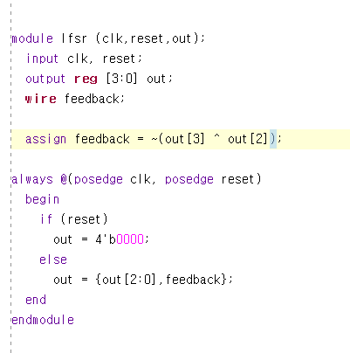
Code Snippet
Random number generator
LFSR(linear feedback shift register)
Linear function
D flipflop

Slide 7
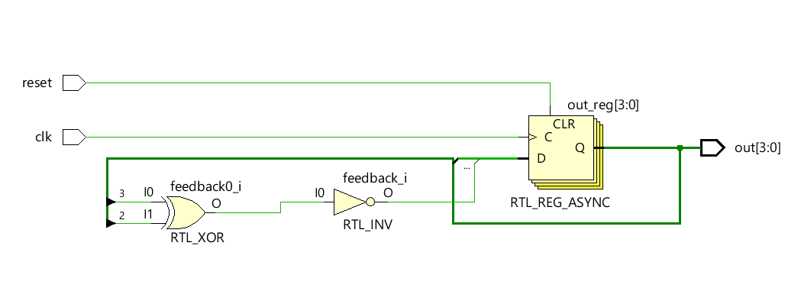
Diagram of lfsr

Slide 8
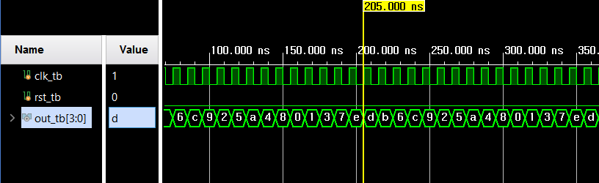
Simulation of lfsr

Slide 9
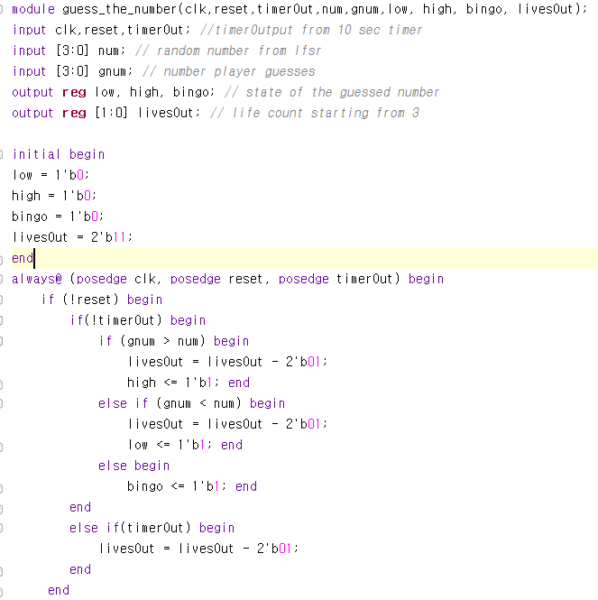
Code snippet
Guess the number

Slide 10
Successes and Failure
We have quite a ways to go in regards to completing the project, so here I’ll talk about projections over reality.
Projected Successes:
random # generator
keyboard input module
stopwatch counter for player timer
Projected Difficulties:
VGA text output
speaker output (buzzer for time’s up)
creation of player profiles (p1 & p2) and keeping track of their “lives”

